Slide 1
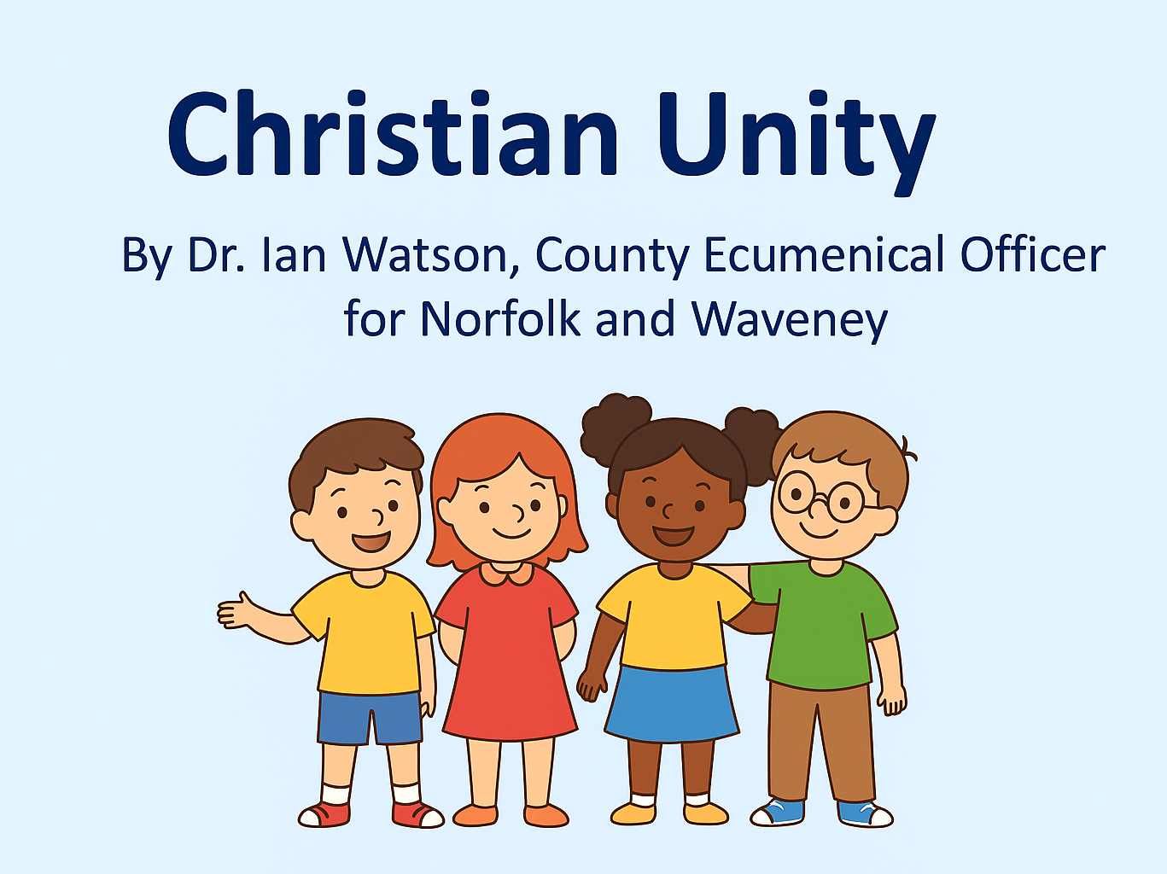

Slide 2
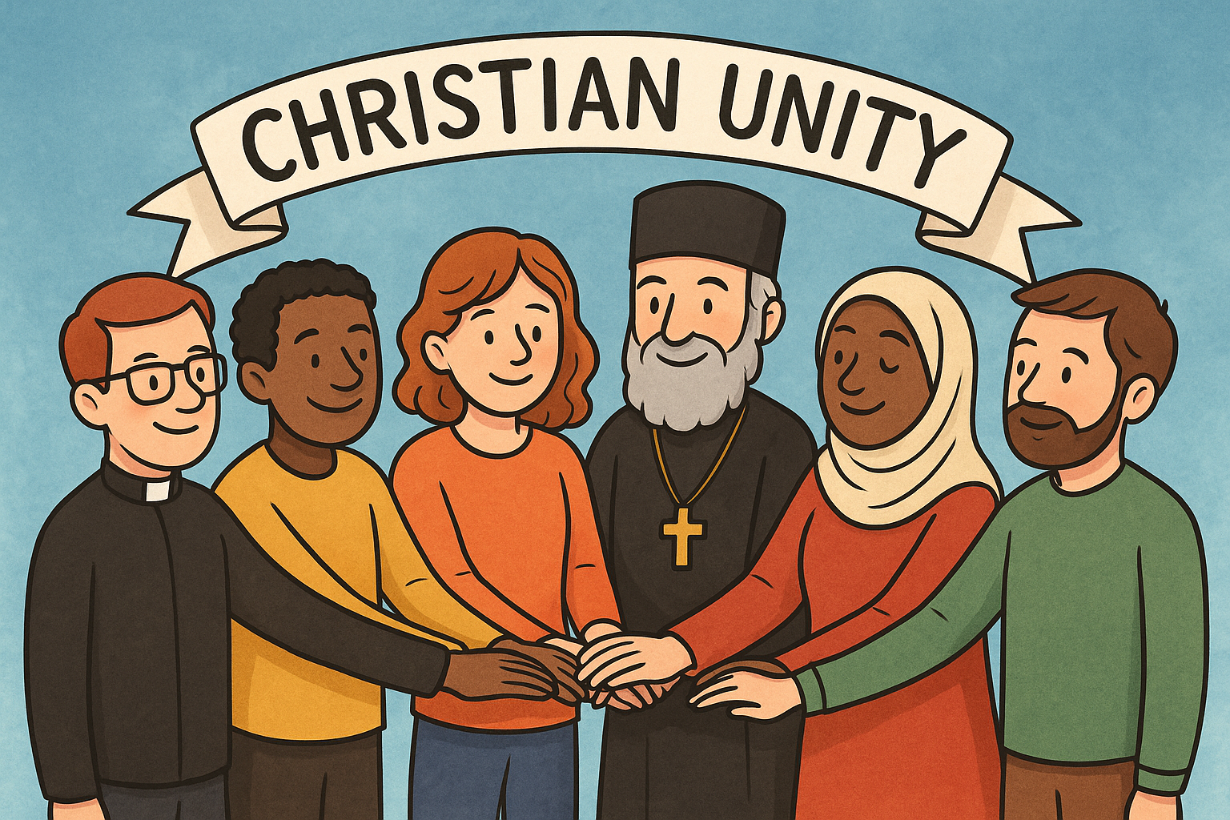
What does Ecumenical mean?
Ecumenical comes from the word Ecumenism.
That’s a big word but don’t worry it just means Christian Unity
People from different Churches who all believe in Jesus and the bible - working and praying together
So, my job is to talk about and help those who want to work together from different churches across Norfolk.
I'll come back to Christian Unity and why it is important in a bit.

Slide 3
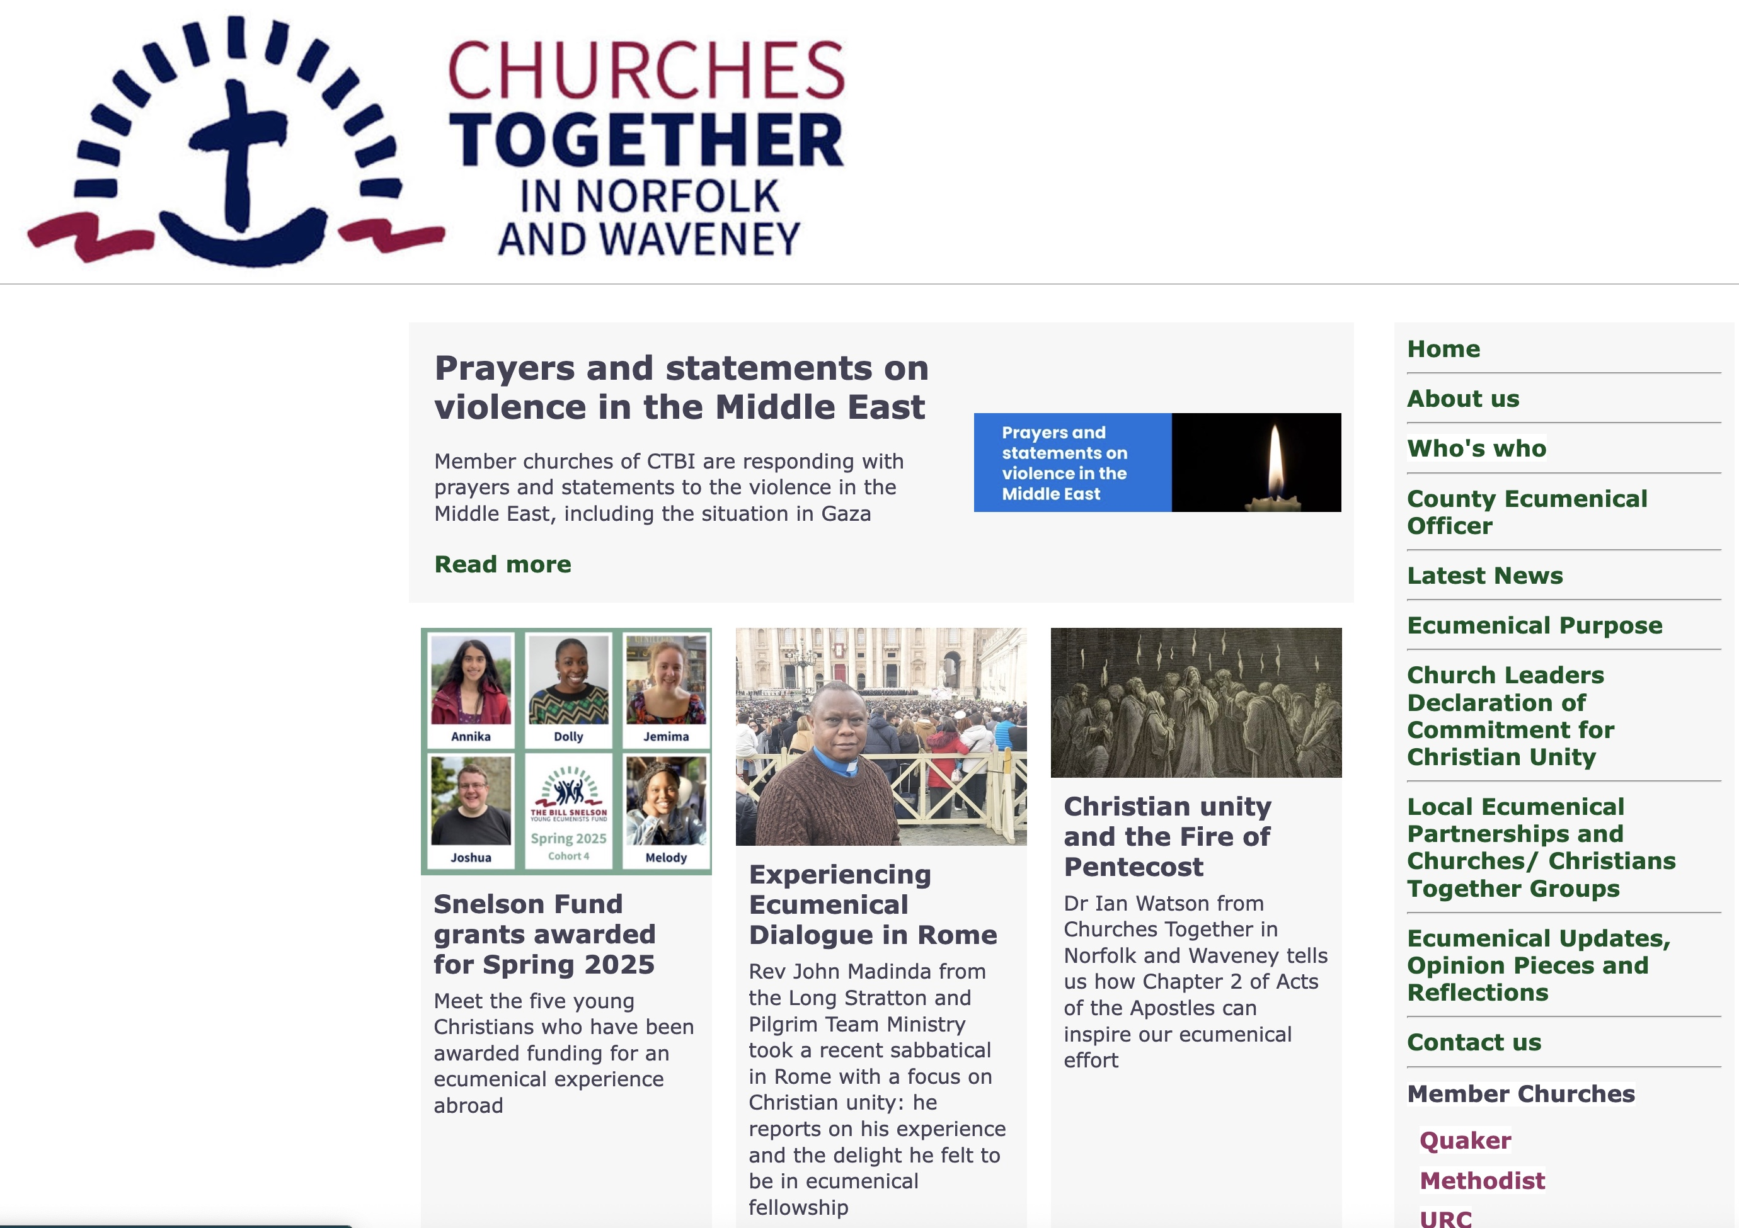
Notes:
I work for a group of senior church leaders in Norfolk. We have a website and the group is called Churches Together in Norfolk and Waveney. The group focuses on what we do in our great county of Norfolk – where you all live. It is part of a much bigger organisation called Churches Together in England.

Slide 4
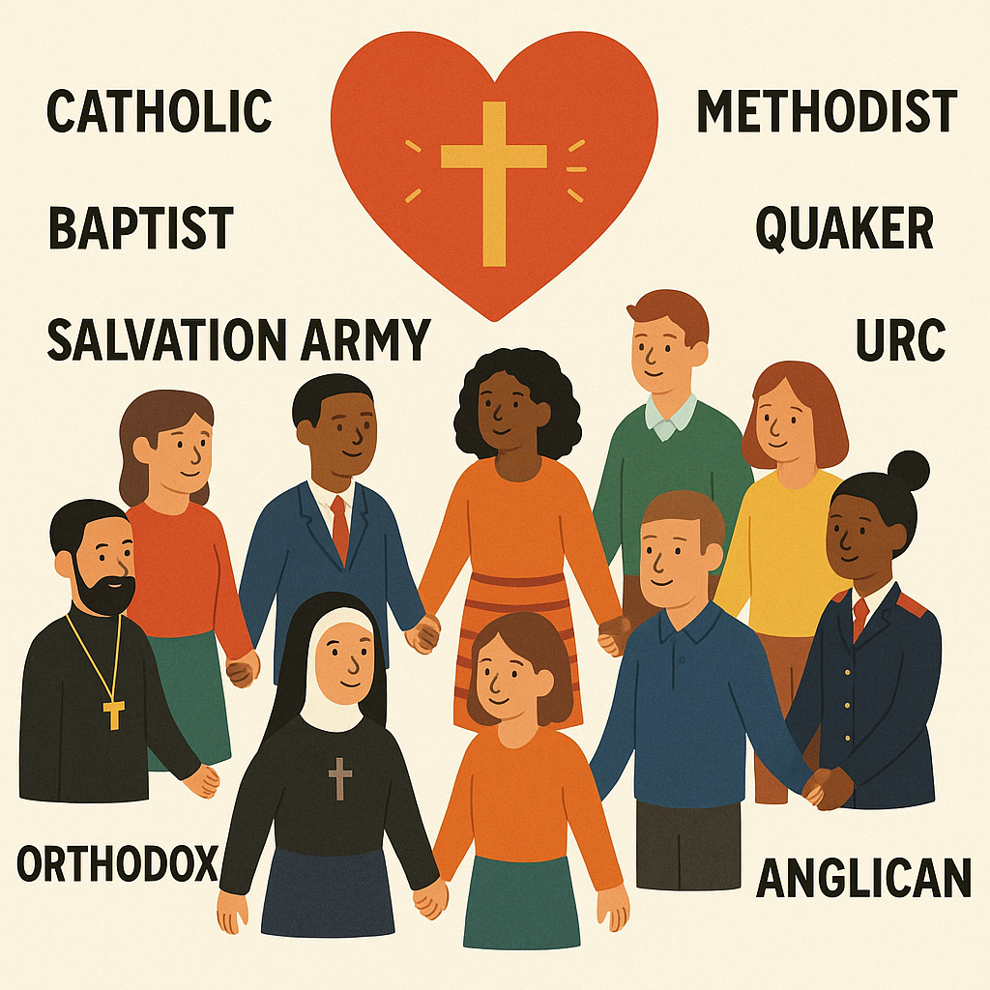
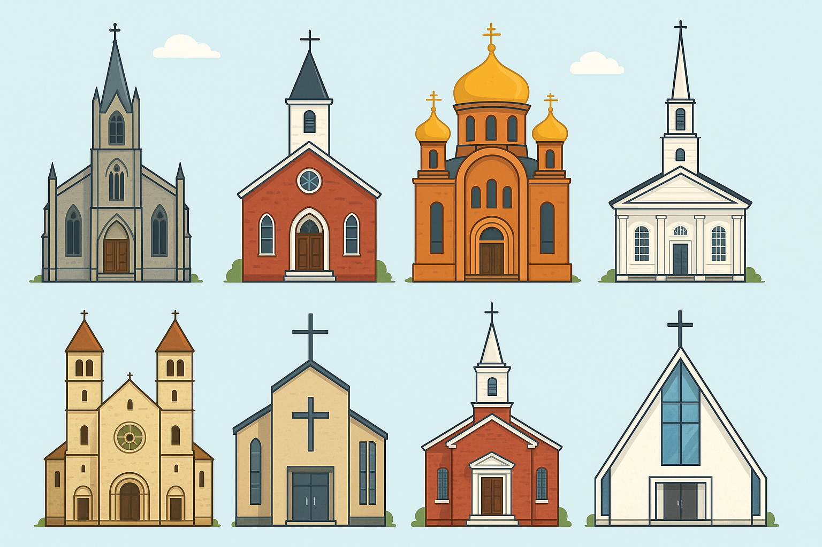
Notes:
Across the world there are many many different Christian churches or traditions like Roman Catholic, Orthodox, Baptists, Anglicans and so on. But can you guess how many there are across the whole world? Nearly 50,000! In England alone we have 50 different churches or traditions. In Norfolk we also have many different churches. In Churches Together in Norfolk and Waveney we have seven member churches, but we have a much greater number of groups where Christians from other churches also work together to serve the people in their local communities.

Slide 5
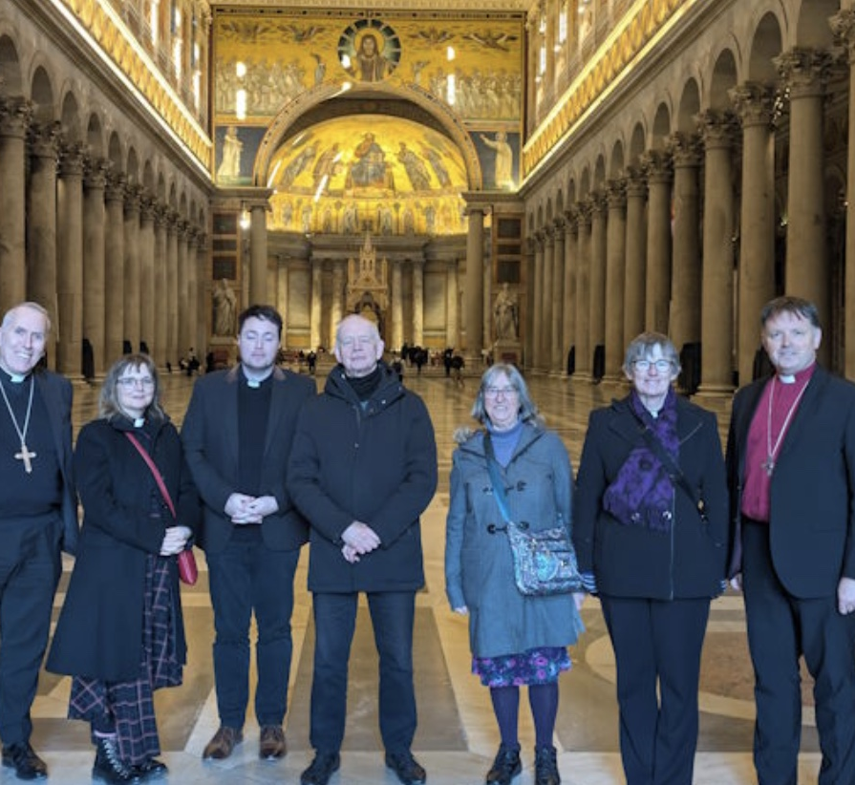
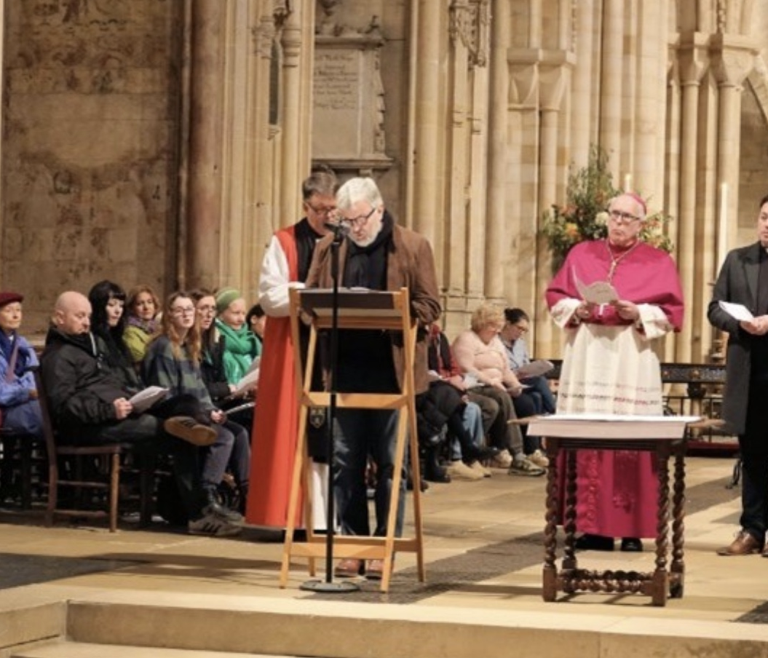
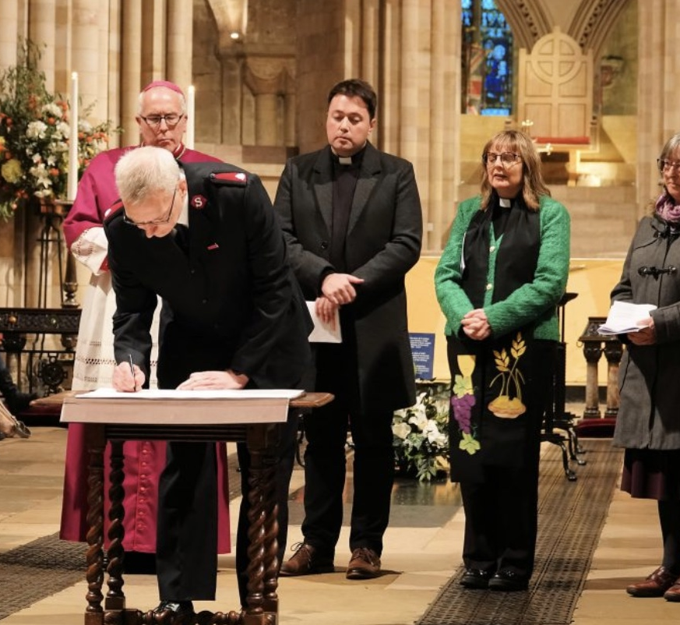
Notes:
Here are three pictures of some of the senior church leaders who make up NWCT. The first is from a pilgrimage to Rome earlier this year to meet the Pope. The picture below and the big picture was taken last year when they signed an agreement in Norwich Cathedral to work together and help each other.

Slide 6
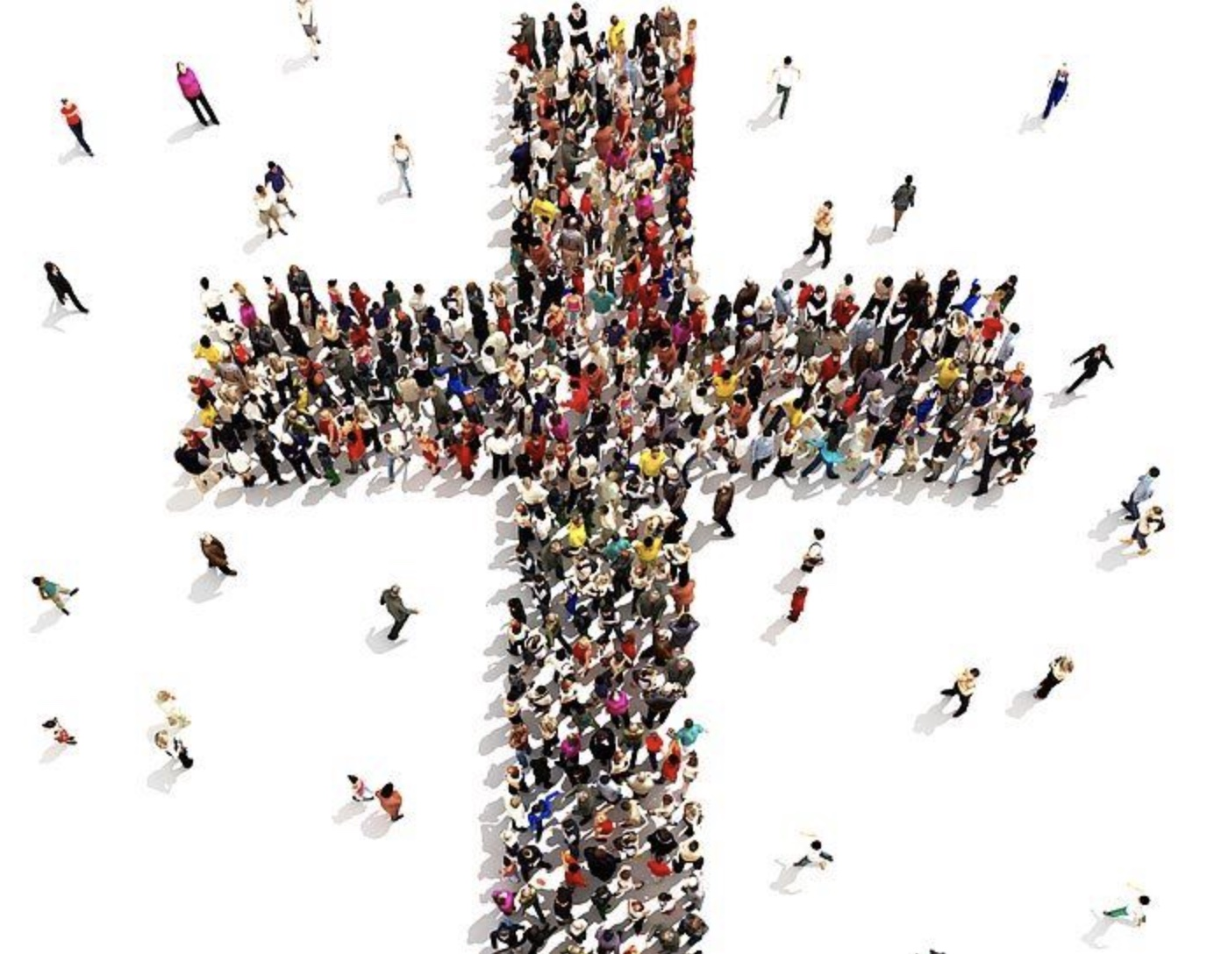
What is Christian Unity?
Christians working together as one big family who all believe in Jesus.
Although we belong to different churches – we are all Christians who love Jesus and want to tell everyone that He loves them.
Christian Unity means loving each other and sticking together even when we disagree with each other.

Slide 7
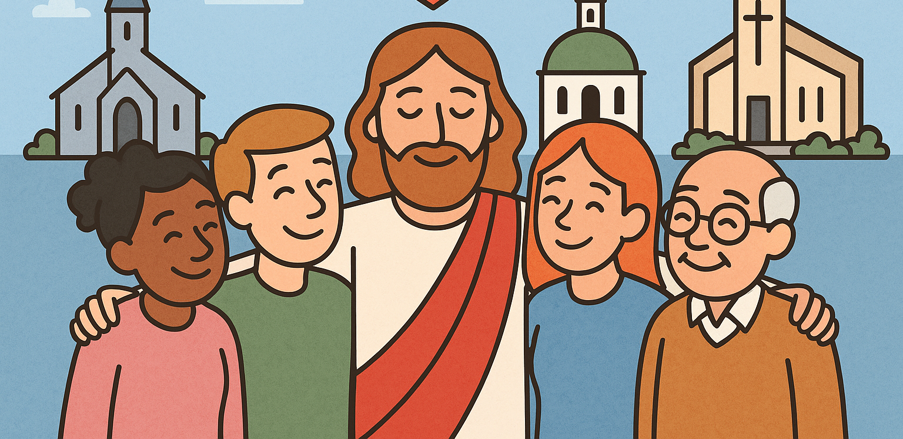
Jesus wants Unity
Jesus wants us to be like one big loving family. He wants everyone who follows Him to stick together, be kind, and help each other — just like good friends do.

Slide 8
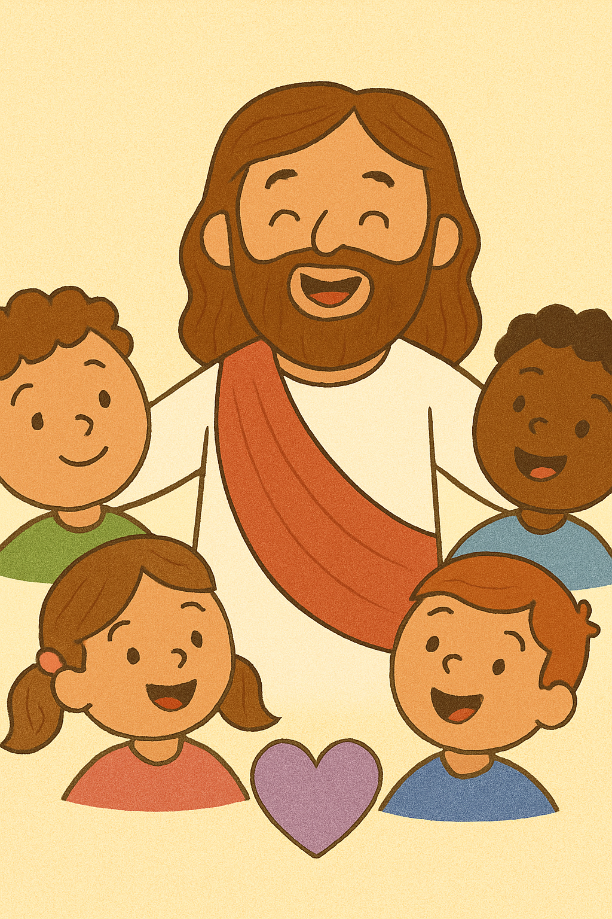
But Why?
Because God is All About Love
God the Father, Jesus the Son, and the Holy Spirit are always together and full of love. Jesus wants us to be like that too — loving and close, not fighting, arguing or being mean.
So the World Can See God’s Love
When people see Christians being kind and working together, they can see how much love Jesus brings. It’s like shining a bright light that shows how good God is.
Because He Told Us to Love Each Other
Jesus said, “Love one another like I love you.” That means we should forgive, share, and be friends, even if we are different or sometimes argue with each other.
To Help Us Work Together
When we are united, we can help more people, pray better, sing louder, and do good things for the world — just like a school team.

Slide 9
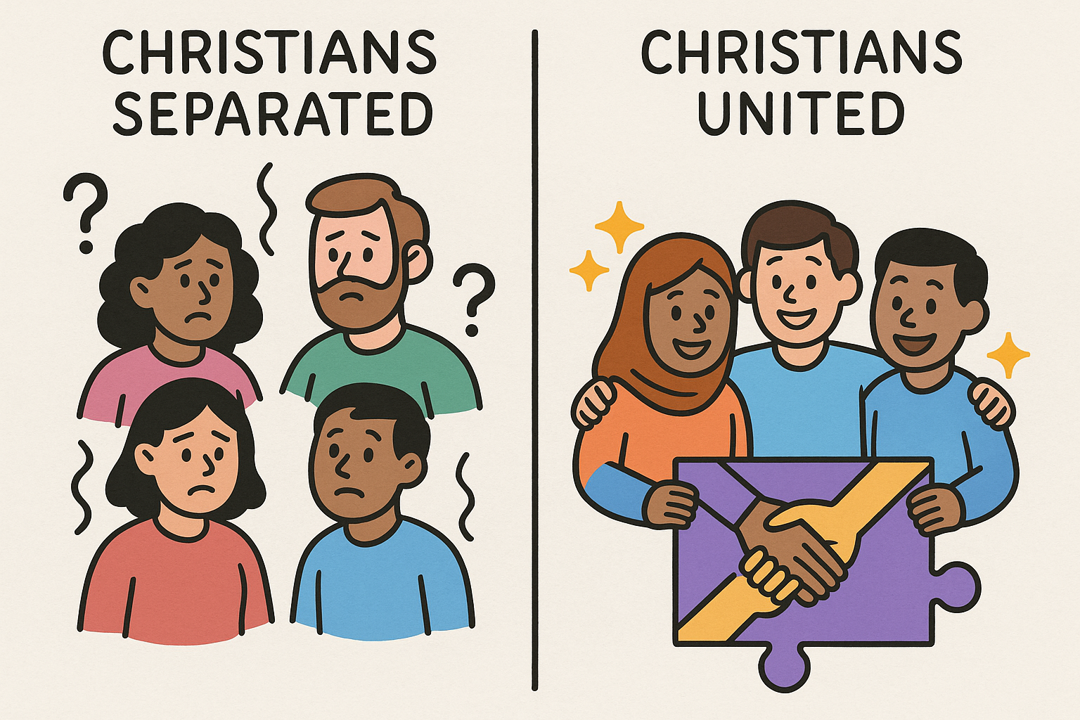
Why is it still important today?
When we love and help each other, people see God's love And are more likely to want to be part of the Church
If we always argue, people may feel sad or confused. Because of this they May not want to be part of the Church

Slide 10
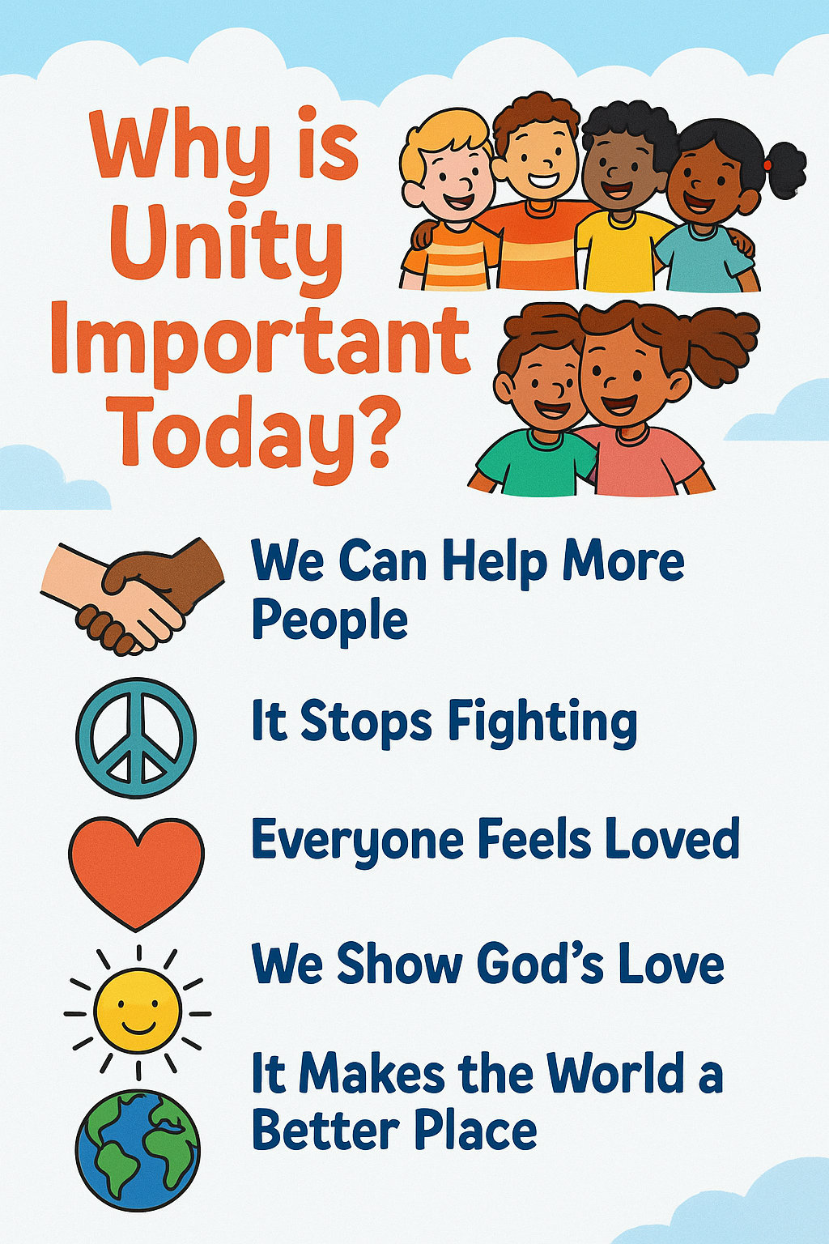
Notes:
Unity means sticking together like good friends and helping one another. It’s important today because the world can be a big, busy place, and we need each other!
We Can Help More People
When we work together, we can share food, toys, and kindness with people who need help. It’s like a big team doing something good!
It Stops Fighting
If we are united, we don’t argue or hurt each other. We talk, we listen, and we say sorry when we need to. That keeps peace in our homes, schools, and churches.
Everyone Feels Loved
When people are united, no one feels left out. Everyone is welcome and cared for — just like Jesus wants.
We Show God’s Love
When we love each other and work together, other people can see how good God is. It’s like being a bright light in a dark place!
It Makes the World a Better Place
Unity helps us to plant gardens, build homes, share stories, and have fun — because when we are kind and together, the world is happier!
Unity is like holding hands, sharing smiles, and being one big family — just the way Jesus dreamed it could be!

Slide 11
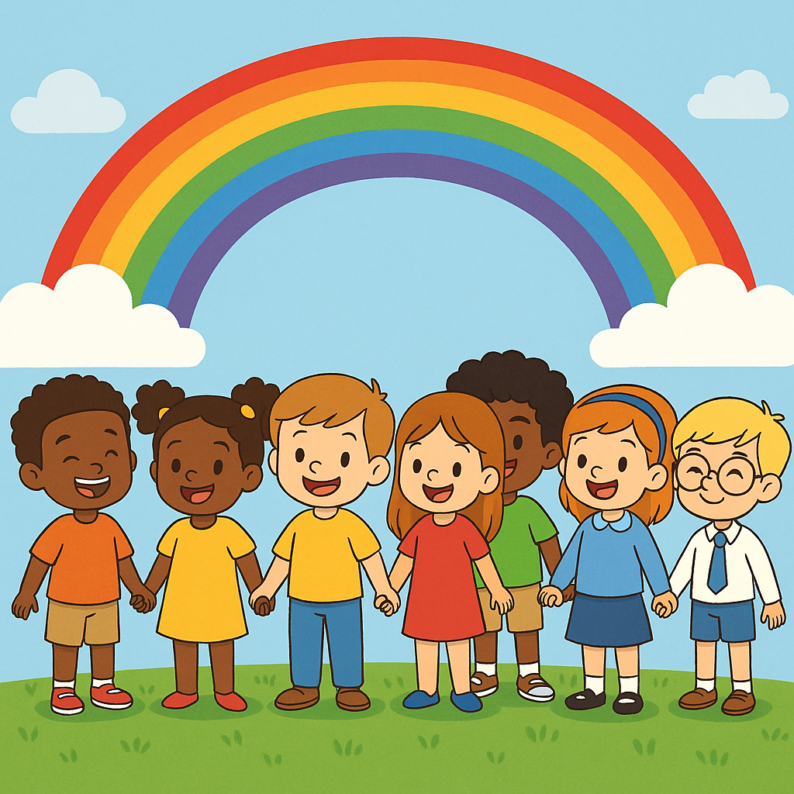
We Don’t Have to Be the Same
Churches can (and do) look and sound different. People find different ways to pray and worship that work best for them.
The aim is not to be the same but be like a rainbow – to have many colours but still be part of one beautiful thing!
We can be different and still be united. There is strength in difference – we can learn from each other and be stronger.
If we are united, then together we are better able to serve the Common Good

Slide 12
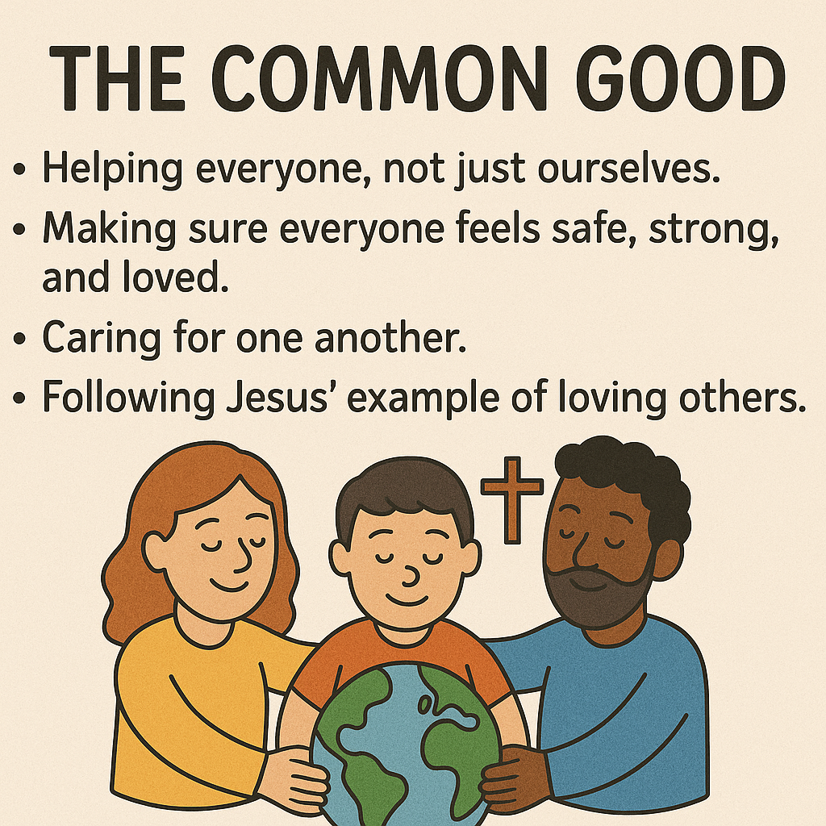
What Is the Common Good?

Slide 13
How can You help with Unity?
Be Kind
Be kind to everyone. Do things for others.
Include
Include others in games and activities.
Help
Help those who are in need, lonely or sad
Look
Look to do good things for others not just for yourself
Pray
Pray for other people – Christians in different churches and to those who are not Christians

Slide 14
Remember
Unity = loving and respecting each other
We are One but not the same. It is ok to be different when we all still believe in Jesus and the bible
Jesus is happy when we work together
We listen to and learn from each other
We walk and pray together as a big family who believes in the love of Jesus

Slide 15

Thank you for listening!

Slide 16

ANY QUESTIONS

